Slide 1


Getting Started with Precious Metals
This guide is intended to help you sort through the sometimes-bewildering array of choices in the marketplace for precious metals today. The specific products we cover here are among the most conservative, widely-traded, highly-liquid, and competitively-priced available. These are the best of the best, in our opinion.
If you have any questions, please feel free to call us at 1-800-613-9323. Our precious metals specialists will be happy to help you.
Sincerely,
Dana Samuelson President
American Gold Exchange, Inc. 1-800-613-9323
www.amergold.com

Slide 2
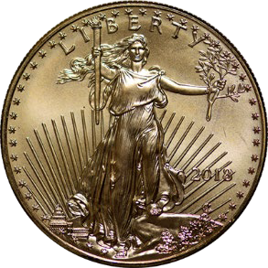
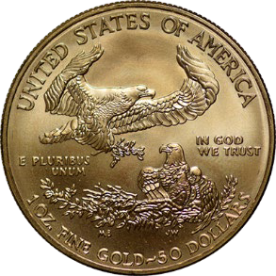
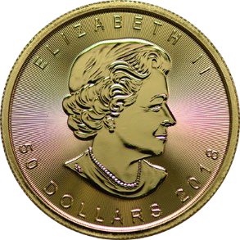
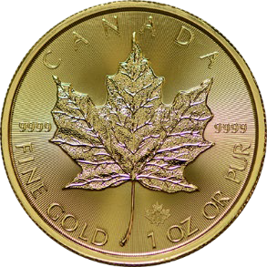
2
Gold Bullion
When people think of gold bullion, they often imagine a huge stack of gold bars in a dusty vault. Since the mid-1980s, however, gold bullion coins issued by government mints have all but replaced private bars as the primary way for individual investors to own physical gold bullion. The US Mint, Royal Canadian Mint, and South African Mint are the main suppliers of modern gold bullion coins to the US.
Government-produced modern bullion coins offer several distinct advantages over other forms of bullion. They are minted to the highest standards. They are guaranteed for purity and content by the issuing government. They are easily transported and stored, often in mint-issued plastic tubes. And they are virtually impossible to counterfeit. Plus, their designs are typically quite beautiful.
#1 – 1-ounce U.S. Gold Eagles
Introduced by the US Mint in 1986, American Gold Eagles are the first choice for modern gold bullion buyers in the United States today. Along with American Gold Buffaloes, they are the only modern gold bullion coins backed by the US government for weight and gold content. They are legal US tender, not replica coins.
US Gold Eagles are available in four sizes: one-ounce ($50 face value), half-ounce ($25 face value), quarter-ounce ($10 face value), and tenth-ounce ($5 face value). They are also available as sets. Each one-ounce American Eagle gold coin contains precisely one troy ounce of pure 24-karat gold.
One-ounce Gold Eagles are by far the most popular and cost-effective of the four sizes. Because the US Mint charges dealers a fabrication cost for each coin, when you buy 1 oz Gold Eagles, you only pay it once. Buying 10 tenth-ounce coins means paying a fabrication cost ten times. On a per-ounce basis, you can readily see why one-ounce coins are more cost-effective.
#2 – 1-ounce Canada Gold Maple Leafs
www.amergold.com

Slide 3
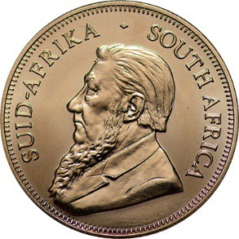
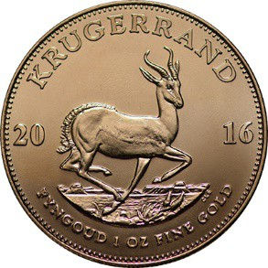
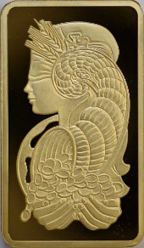
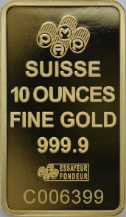
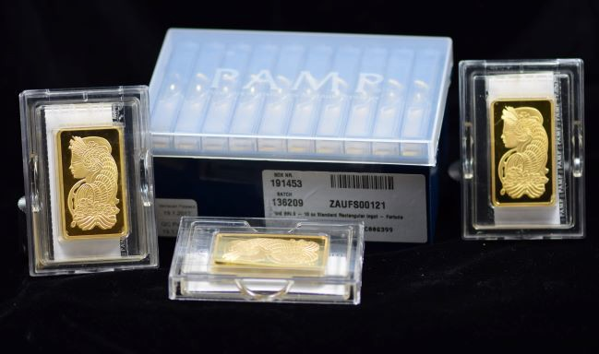
3
Our second-most popular gold bullion coin is the 1 oz Gold Maple Leaf, manufactured since 1979 by the Royal Canadian Mint. Struck in 99.99% fine gold, the Canadian Maple Leaf is among the purest gold coins in the world. Many gold investors prefer the purity of the Maple Leaf to American Eagles, which contain a full ounce of pure gold but also have small amounts of copper and silver added to increase durability.
#3 – 1-ounce South Africa Gold Krugerrands
1 oz South Africa Gold Krugerrands are a low-priced, high-quality bullion coin that is avidly traded throughout the world. First issued in 1967, Krugerrands were the bullion gold coin of choice until the advent of the American Gold Eagle in 1986 and remain one of the most successful of all modern gold bullion coins.
If these top three gold coins were ice cream flavors, they would be vanilla, chocolate, and strawberry, the most popular flavors. But just like ice cream, there are many more than just these three. Today sovereign minted gold coins are available from Australia, China, Austria, Singapore, Great Britain, and the list keeps growing.
Privately Minted Gold Bars
While government-minted bullion coins are the most popular, safest, and most convenient way to buy gold, some investors still prefer gold bars. We also make a buy/sell market in high-quality bars from Credit Suisse, Pamp Suisse, Royal Canadian Mint, and Valcambi. Sizes are 1 -ounce, 10-ounce, 1-kilogram (32.15 ounces), and 100-ounce.
Buyer Beware!
We have seen a small but growing problem with counterfeit "gold bars" fashioned to look like the genuine ones listed above. Typically produced in China, these fraudulent bars are usually made of
www.amergold.com

Slide 4
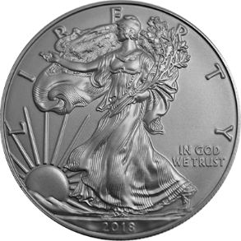
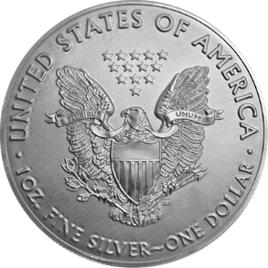
4
tungsten covered in a layer of gold. Tungsten has a similar density to gold, so when the bars are weighed and measured, they are close to what real bars should be.
While counterfeit bars won't deceive most professional dealers, they can fool the unsuspecting public. Like most reputable dealers today, we have sophisticated testing devices to verify the integrity of the bars we buy from sellers whom we don’t know. These devices are cost-prohibitive for non-professionals to own. You should only buy gold bars from a seller you truly trust.
The designs on bars are much less intricate than on sovereign-minted bullion coins, so counterfeit bars are more difficult for the average investor to spot. Smaller-sized bars are especially problematic. This why we recommend that new buyers shy away from gold bars altogether. We have more to say on this in our Do’s and Don’ts section below.
Silver Bullion
Silver bullion is popular in modern investment portfolios because, like gold, it typically has low correlation with stocks and bonds, enabling investors to diversify their risk profile. Investors also buy silver bullion as a hedge against inflation and as a "currency of last resort" during times of political or economic instability.
The most popular silver products are modern bullion coins like 1-ounce U.S. Silver Eagles and 1-ounce Canada Silver Maple Leafs. U.S "Junk" 90% silver coins are also an excellent way to buy low-cost, high- quality silver. For larger purchases, 100-ounce silver bars from the Royal Canadian Mint (RCM) or Asahi (formerly Johnson Matthey) are also excellent options.
#1 – 1-ounce U.S. Silver Eagles
Silver Eagles are the most popular silver bullion product in the U.S. Containing a full ounce of .999 fine silver and backed by the U.S. government for weight and metal content, Silver Eagles are among the safest and most convenient ways to invest in silver bullion.
Issued since 1986 as legal tender by the U.S. Mints in Philadelphia and San Francisco, Silver Eagles are only available in the 1 oz size with a face value of $1.00. The obverse depicts the memorable Walking Liberty design by Adolph A. Weinman, adapted from the popular U.S. quarters and half dollars. The reverse features the Heraldic Eagle design by John Mercanti.
www.amergold.com

Slide 5
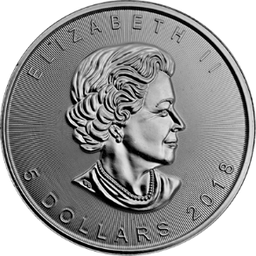
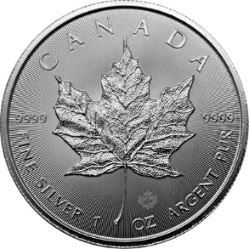
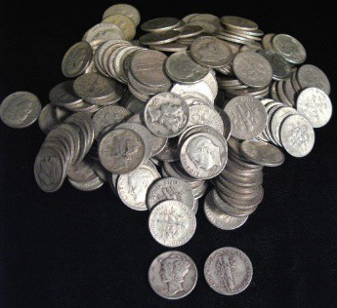
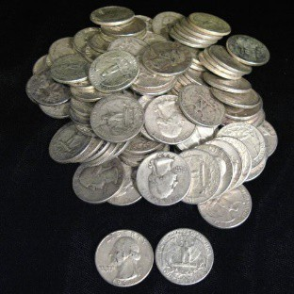
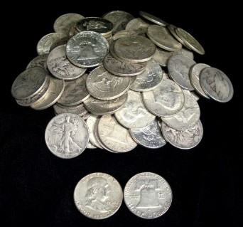
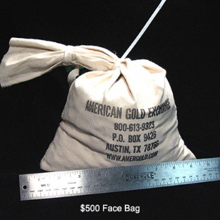
5
#2 – 1-ounce Canada Silver Maple Leafs
Beautifully struck in 99.99% pure silver, Silver Maple Leafs are guaranteed by the Royal Canadian Mint for purity, weight, and content. Starting with the 2017 issue, Silver Maple Leaf coins have cutting-edge security features including precise radial lines on the obverse and reverse, and a micro engraved maple leaf on the reverse for authenticity.
#3 – Pre-1965 U.S. "Junk" 90% Silver Coins
We really like U.S. 90% (or "junk") silver coins. These are dimes, quarters, or half dollars minted in 1964 and earlier, when U.S. coinage was still made of real silver (90% silver, 10% copper). 90% junk silver is one of the most cost-effective ways per ounce to buy bulk silver because no fees for refining or minting have been added to the cost.
Modern silver bullion coins and bars always pass along a small manufacturing premium to the investor. Not so with 90% U.S. junk silver. These coins were made years ago by the U.S. Mint, free of charge, for use as currency. Today that means you get more silver for your money.
Apart from superior cost-efficiency, another advantage of U.S. 90% junk silver is the trading flexibility it provides. You can buy in the denomination of your choice, so you have incremental size alternatives that do not exist with 100-oz. silver bars or even 1-oz. American Silver Eagles. In fact, you can trade in increments as small as one dime if you choose.
We sell 90% junk silver bags of dimes, quarters, or half dollars but not mixed bags. A $1,000 face-value bag is close to the size of a football and weighs 55 lbs. A $500 face-value bag, like the one pictured above, contains half as many coins, half as much silver, and is half as large and heavy.
www.amergold.com

Slide 6
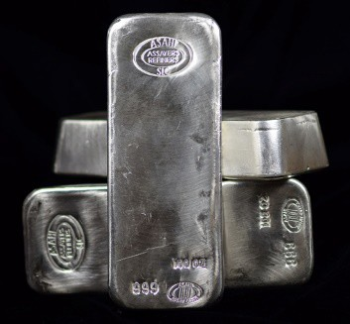
6
100-ounce Silver Bars
100-ounce silver bars are also a cost-efficient way to buy bulk silver. Their large size results in very little fabrication cost per ounce, which means you get more silver for your investment dollar. We trade in Asahi (formerly Johnson-Matthey) and Royal Canadian Mint (RCM) 100-oz bars, which contain a full 100 troy ounces of .999 fine silver, making them among the purest silver bullion products available.
Pre-1933 U.S. Gold Coins
As a smart alternative to modern bullion coins, we recommend "common date" US gold coins minted pre-1933. These old coins were produced by the U.S. government for use as currency before 1933, when gold was still used as money. They are priced according the spot gold price plus a premium based on their overall scarcity, grade, and demand in the market.
Although called "common dates," they are quite scarce. Of the many millions originally minted, almost all were heavily used in circulation during the 1800s and early 1900s, and many were melted down during the federal gold recall in the 1930s. Only a small fraction of the original mintage survives today, especially in the higher Mint State grades.
The fundamental scarcity of these classic gold coins can mean substantially higher premiums over their intrinsic gold value during periods of heightened demand or a rising gold price. This is what we call their "double play" leverage: the proven ability to rise by more than the gold price because of fundamental scarcity and restricted supply in the national market.
Better than Gold Bullion
In our experience, these common-date, pre-1933 U.S. gold coins are better than gold bullion for bulk gold buyers and investors. They offer all the benefits of gold bullion plus extra benefits like limited supply, collector demand, financial privacy, and extra premium potential because of scarcity.
Modern gold bullion coins, because they are made in virtually unlimited quantities every year, offer no significant premiums for scarcity. And while many modern bullion coins are subject to broker reporting requirements to the IRS, collectible coins of historical significance, like pre-1933 US gold coins, are exempt from these requirements, giving you more financial privacy.
www.amergold.com

Slide 7
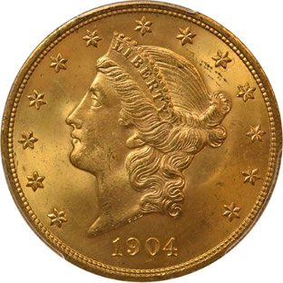
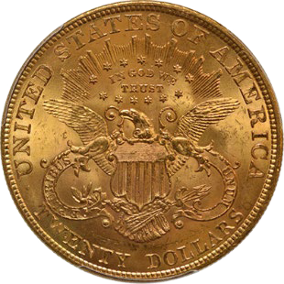
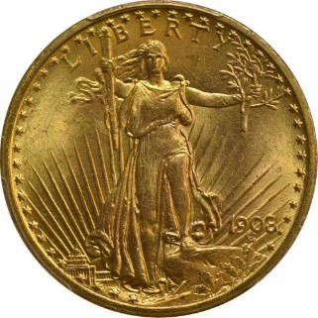
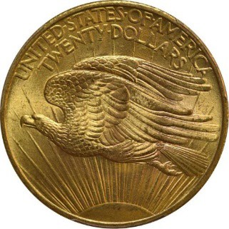
7
#1 – U.S. $20 Gold Double Eagles
For new investors, we typically recommend the larger-sized Pre-1933 US Gold Coins like $20 Saint- Gaudens Double Eagles, $20 Liberty Double Eagles. These denominations are by far the most commonly traded and feature the largest gold content. Each $20 coin contain 0.9675 ounces of pure gold.
$20 gold double eagles can trade at very close to their gold content value in XF or AU grade, making them a fine bullion substitute. In higher Mint State grades like MS65, they can command large premiums for scarcity and collector value, making them an excellent investment coin.
$20 Liberty Type 3 (1877-1907)
$20 Liberty gold double eagles are one of the world's most recognized gold coins. A workhorse coin of commerce, it was one of the building blocks of the growing U.S. economy and financial markets in the 19th and early 20th centuries.
Also known as Coronet Double Eagles because of the coronet, or crown, adorning the head of Liberty on the obverse, $20 Liberty gold coins were used in every aspect of American economic life. The classic portrait of Miss Liberty on the coin's obverse and the bold heraldic Eagle on its reverse stand as inspiring symbols of America's emergence as a mature world power during this wild and exciting period in our nation's history.
$20 Saint-Gaudens (1907-1933)
The Saint-Gaudens $20 Double Eagle one of the most beautiful, popular, and widely recognized of all gold coins. The last $20 gold piece struck by the U.S. government for regular issue, it will forever remain a symbol of the emerging greatness of the United States in the 20th Century.
www.amergold.com

Slide 8
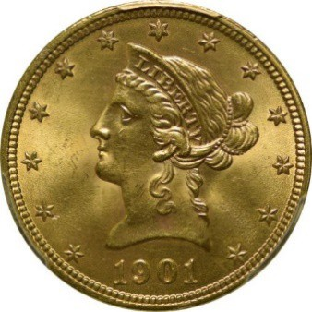
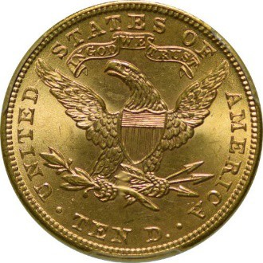
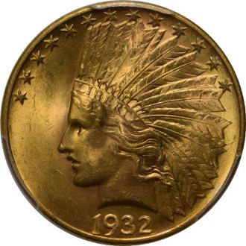
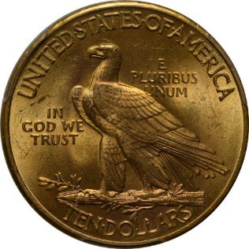
8
$20 Saint-Gaudens gold coins are a perennial favorite for gold coin collections and investment portfolios because of their stunning design, genuine scarcity, and worldwide popularity. Especially in the higher Mint State grades like MS64 and MS65, they have the proven ability to appreciate at times in a rising gold market much faster than gold bullion because of their severely limited numbers and constant collector demand.
#2 – U.S. $10 Gold Eagles
Also popular among gold investors are U.S. $10 gold coins, like the $10 Liberty and the $10 Indian. Like
$20 Gold Eagles, they are avidly sought by investors and collectors for their beautiful design, excellent minting, and large gold content. These coins contain half as much gold as $20 double eagles at 0.48375 ounces of pure gold per coin.
$10 Liberty With Motto (1877-1907)
10 Liberty gold eagle coins were introduced by the U.S. Mint in 1838 and continued in production until 1907 with only one substantial design change, the addition of the motto IN GOD WE TRUST on the reverse in 1866. The first variety, the "No Motto" $10 Liberty gold eagle, was minted from 1838 to 1866. The second variety, the "With Motto" $10 liberty, was made from 1866 until 1907.
$10 Indian (1907-1933)
Indian Head $10 gold coins, or gold eagles, were produced by US Mint each year from 1907 to 1916, and then intermittently until 1933. Replacing the Liberty (or Cornet) gold eagles that had been produced since 1838, Indian gold eagles were the last $10 gold coins minted for circulation. Today, they are avidly sought by investors and collectors for their beautiful design, excellent minting, and large gold content.
www.amergold.com

Slide 9
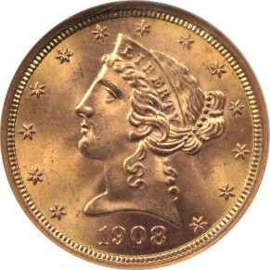
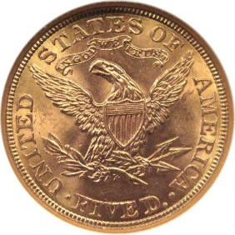
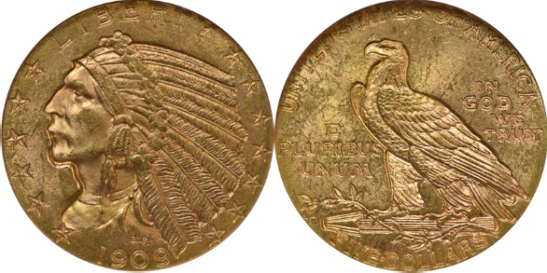
9
#3 – $5 Half Eagles, $2.50 Quarter Eagles
Excellent investment opportunities also exist in the smaller denominations like the $5 Liberty, $5 Indian,
$2.50 Liberty, and $2.50 Indian. Their smaller size makes them less popular among average gold bullion investors, which means they often carry much smaller premiums than their overall scarcity should generate. There are great deals to be had in the current market. (Note: $2.50 Quarter Eagles look identical to the $5 Half Eagles below.) $5 coins contain 0.2410 ounces of pure gold. $2.50 coins contain 0.12094 ounces of pure gold.
$5 Liberty with Motto (1866-1907) $5 Indian (1908-1929)
AGE offers highest-quality coins at each grade level. All our certified coins have been graded and authenticated by NGC or PCGS, the most trusted independent coin grading firms in the industry. Plus, we cherry-pick the national market for the best coins in each grade. Rest assured that you will not find better coins at lower prices than ours. Your satisfaction is guaranteed.
Pre-WWII European gold coins
European and world gold coins are an overlooked but very promising sector of today's gold market for bulk gold investors and collectors. Minted mostly pre-1935, these classic gold coins from many nations offer all the benefits of modern gold bullion coins plus extra benefits like limited supply, collector demand, financial privacy, and extra premium potential because of scarcity.
We general trade European gold coins minted after 1800, which are more readily found today. Most contain one-fifth to one-quarter of an ounce of gold. Many are relatively common, with large quantities surviving in Brilliant Uncirculated (BU) grade. Therefore, they trade remarkably close to their intrinsic gold content today, making them an excellent—and far more interesting—substitute for modern bullion coins.
AGE offers a wide variety of high-quality European and World gold coins. All our coins are carefully hand-selected for quality and eye-appeal. Please call and speak to one of our knowledgeable account managers for the best values in today's market.
www.amergold.com

Slide 10
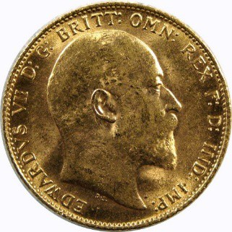
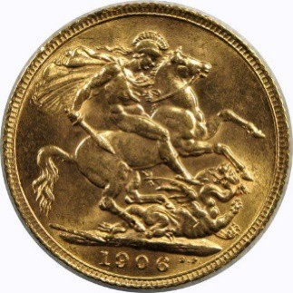
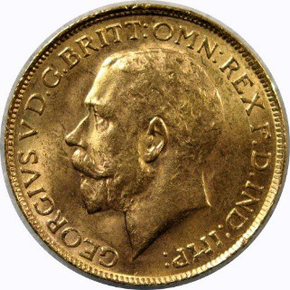
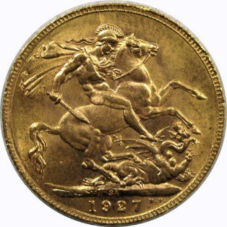
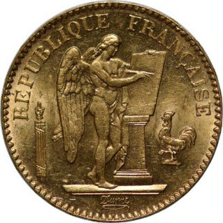
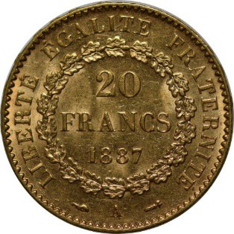
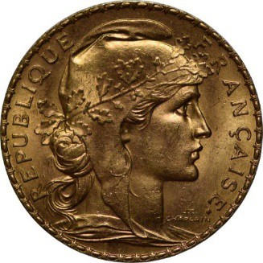
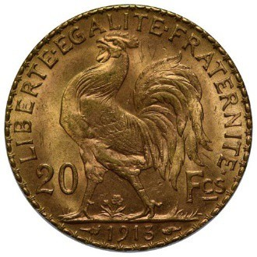
10
#1 – Britain Gold Sovereigns – 0.2354 oz gold
Edward VII (1902-1910)
George V (1911-1935)
British sovereigns are perhaps the most widely recognized gold coins in the world. They were minted for more than 100 years in 11 designs at seven Royal Mints on five continents, during the era when "the sun never set on the British Empire." So universally recognized are gold sovereigns that they were even included in U.S. aviator survival kits during World War II and Operation Desert Storm.
Sovereigns are similar in size and weight to modern 1/4-oz American Gold Eagle bullion coins. The Edward VII and George V designs above are the most widely-traded. Each coin contains 0.2354 ounces of pure gold.
#2 – France Gold 20 Francs – 0.1867 oz gold
"Angel" (1871-1898)
"Rooster" (1906-1914)
France gold 20 franc coins have been among the most popular and important gold coins in the world for almost 200 years. Today, gold investors and collectors seek them out for their rich history, fine minting, and beautiful designs.
France 20 gold francs became the model for gold coinage in much of the rest of Europe. Under the Latin Monetary Union of 1865, Switzerland, Italy, Belgium, and later Greece agreed to standardize their gold coins for size and weight on the French 20 franc. Known today as "the euro before the euro," this LMU standard for gold coins eased trade by making European currencies interchangeable.
www.amergold.com

Slide 11
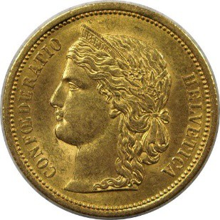
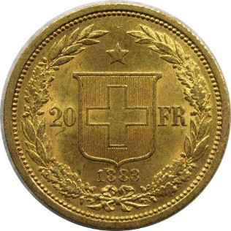
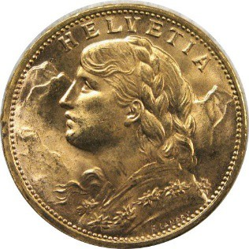
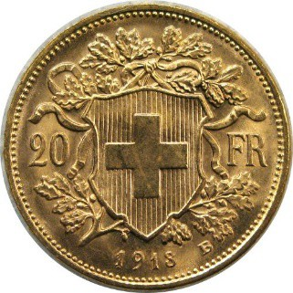
11
The Angel and Rooster designs, above, are the most popular and widely traded in Brilliant Uncirculated (BU) grade. Each coin contains 0.1867 ounces of pure gold.
#3 – Switzerland Gold 20 Francs – 0.1867 oz gold
"Helvetica" (1886-1896) "Helvetia" (1897 – 1935, 1947, 1949)
Swiss 20 franc gold coins are also extremely popular and widely traded in Brilliant Uncirculated (BU) grade. Based on the LMU standard, they are the same size and weight as French 20 franc gold coins, with each one containing 0.1867 ounces of pure gold.
DOs and DON'Ts of Physical Precious Metals
#1 – First and foremost, find a reputable dealer you can trust
The most important aspect of buying and selling physical precious metals is to deal with a longstanding and reputable dealer. The retail precious metals industry is largely unregulated. Anyone can become a dealer. With the precious metals surge in the late 1970s, and again following the 2008 financial crisis, opportunists popped up in the marketplace, only to disappear when the market contracted. You don’t want one of these opportunists holding your money when they decide leave. Most reputable dealers today have been in industry for decades and have survived previous bear markets.
These days you can easily learn about your prospective dealer’s track record and history through internet searches, including their credentials and customer reviews. Are they referred or recommended by someone you trust? Do their customers give them high marks through review services like Trust Pilot or through other social media review sites? If you see multiple complaints, be very careful.
Reputable dealers will make you, their client, a competitive buy/sell market and will buy back coins and bars they have sold you.
Once you find a dealer you trust, it is generally a good idea to stay with them. The more business you do with the same dealer, the more they will be inclined to offer you special deals that always come along. For the most part, all retail gold dealers are small business owners. Each client is precious to us. You will become a valuable client to your dealer, and you will often be rewarded for your loyalty with preferred treatment.
www.amergold.com

Slide 12
12
#2 – Avoid private sales and online platforms
Most of the problems we see with counterfeit and problematic coins and bars originate in private transactions via non-professional or online selling platforms where anyone can list items for sale. In most instances, these are items that are priced lower than market rates. Deals that are "to good to be true" usually are. Unless you buy through a reputable dealer, you may inadvertently become the victim of fraud.
#3 – Take delivery of your purchases
We do not recommend that you store your purchases with your dealer. Too many things can go wrong, and you surrender the security of having your precious metals in your possession. Sometimes dealers who have financial problems become slow to delivery your product when you most need it.
When you receive your delivery, make sure you to check it thorough to make certain you received what you ordered. If you have any issues or questions, call your dealer immediately. It is our policy at AGE to videotape every package we open and close in order to have an indisputable, video record of what we received and what we shipped.
#4 – Only use an independent, respected facility for storage
We do not normally recommend you store your metals unless your IRA requires it by law or the volume of your portfolio renders it unsafe to store yourself. If you prefer to store you precious metals outside of your possession, use only an independent and respected facility that specializes in precious metals storage. Again, leaving them with your dealer is not a recommended practice.
There are several precious metals storage facilities that pride an excellent service. If you wish to explore this option, please call us for our recommended storage facilities. We only recommend trusted industry professional facilities that specialize in this niche business. Storage fees can vary from facility to facility and based on the value or volume of what you are storing.
#5 – Beware of loss leaders
Some precious metals telemarketers or television sales pitches offer low priced items at "dealer cost" or "direct from the mint" to entice you into doing business with them. Often these deals are not what they seem, and result in bait-and-switch. And once you provide your contact information, you may be deluged by telemarketing calls from fly-by-night companies to whom your information has been sold.
Reputable dealers will respect your privacy.
If you don’t know a dealer, we recommend making initial contact via email. This is a simple way to test the waters, see how they treat you, and protect your privacy as you vet them.
www.amergold.com

Slide 13
13
Thanks for your time!
Thanks for giving me the opportunity to sketch out the precious metals market and the best options for getting started. If you have any questions regarding buying or selling, simply call 1-800-613-9323 or email info@amergold.com and we’ll help you any way we can.
Happy Investing!
Best regards,
Dana S Samuelson
Dana Samuelson President
American Gold Exchange, Inc.
About Dana S. Samuelson
A professional numismatist since 1980, Dana worked for some of the most influential precious metals trading companies in the nation before founding AGE in 1998. For nearly a decade he was a personal protege of James U. Blanchard III, one of the true giants of the industry and the individual most responsible for re-legalizing the private ownership of gold in the U.S. Dana recently served as President of the Professional Numismatists Guild, an nonprofit organization of the world's top rare coin experts, whose primary mission is to make the hobby safe for collectors and investors by maintaining rigorous standards of excellence among dealers. He holds a B.A. from Washington and Lee University.
About American Gold Exchange
Founded in 1998, American Gold Exchange is a leading national precious metals and rare coin company specializing in dealer-to-dealer trading and direct sales to the public. AGE draws upon a huge network of gold, silver, platinum and palladium suppliers in the U.S. and Europe. Our long-term relationships enable us reliably to offer an almost limitless inventory of highest-quality coins and bullion at extremely low prices.
At AGE, we put the customer first. Our account managers are specifically trained to take as much time as you need, regardless of portfolio size, until you feel comfortable and informed about the market and the benefits of our products. Our prices on coins and bullion are always among the lowest in the industry, and our quality is the highest. Each classic coin is hand-selected for superior collector desirability based on technical merit.
www.amergold.com

Slide 14
14
As a result, we're pleased to say, an AGE customer is usually a customer for life! That's why AGE has been recommended by Dr. Steve Sjuggerud's Daily Wealth, Peter Schiff of Euro Pacific Capital, Porter Stansberry, and Mary Anne & Pamela Aden of The Aden Forecast as a trusted source for classic coins and bullion
www.amergold.com

